Slide 1
Introduction to Email Spam Classification
Email spam classification is the process of segregating emails into spam and non-spam categories using various techniques and tools.

Slide 2
What is NLP (Natural Language Processing)?
Language Understanding:
NLP involves the use of computational techniques to analyze and understand human language.
AI Technology:
NLP is a branch of artificial intelligence focused on the interaction between computers and human language.
Data Interpretation:
NLP enables machines to interpret, understand, and respond to human language in a meaningful way.

Slide 3
Importance of Email Spam Classification
Securing Communication:
Email spam classification ensures secure and private communication by filtering out unwanted and potentially harmful content
Data Privacy:
It helps in safeguarding sensitive information and maintaining the privacy of users' data.
Cybersecurity:
Email spam classification plays a crucial role in protecting individuals and organizations from cyber threats.

Slide 4
Techniques used in Email Spam Classification using NLP
Supervised Learning:
Using labeled data for training classification models.
Unsupervised Learning:
Clustering and outlier detection without labeled data.
Hybrid Approaches:
Combining supervised and unsupervised techniques for improved accuracy.

Slide 5
Data Preprocessing for Email Spam Classification
1.Data Cleaning
Removing duplicate, irrelevant, or noisy data to enhance data quality.
2.Tokenization
Breaking down free-flowing text into words, phrases, symbols, or other meaningful elements.
3.Normalization
Standardizing text data to a common format for consistent analysis.

Slide 6
Feature Extraction for Email Spam Classification
Bag of Words:
Converting text data into a sparse matrix of word frequencies.
TF-IDF:
Assigning weights to words based on their importance in a document.
Word Embedding:
Representing words as dense vectors to capture semantic meanings.

Slide 7
Evaluation and Performance Metrics for Email Spam Classification
Accuracy
Percentage of correctly classified emails out of the total number of emails.
Precision
Ratio of correctly classified spam emails to the total classified spam emails.
Recall
Ratio of correctly classified spam emails to the total actual spam emails.

Slide 8
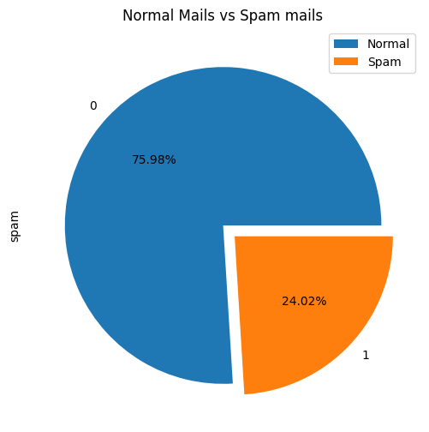
Output:

Slide 9
Thank you

